Slide 1
Unpacking Mathematics
Notes:
What you can say – To assist with the transition to the Next Generation Mathematics Learning Standards, a team of NYS educators developed a series of unpacking documents that demonstrate one method of analyzing a specific standard designed to help illustrate what student learning might look like with regard to that standard. Educators are encouraged to add on to these documents and adapt them to best fit the needs of their learners, as well as work through the process of unpacking other grade-level standards, which will provide an opportunity for reflective practice and aid in lesson planning.
During this session, we will engage in a process to unpack a standard to help develop a clarity around the intent and rigor of the standard(s). Developing a better understanding of the content standards will help with the designing and teaching of curriculum.
Additional Notes – Goal is for teachers to engage in process so they experience unpacking and understanding the standards

Slide 2
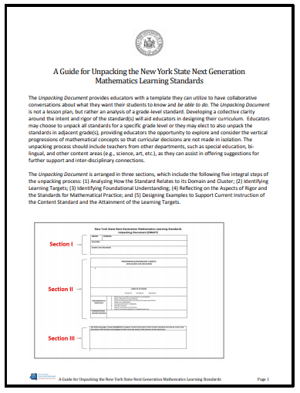
Unpacking Guide
Notes:
What you can say – The unpacking document is not a lesson plan, but rather an analysis of a grade-level standard that can be utilized to have collaborative conversations about what students need to know and be able to do.
The unpacking document is arranged in three sections which contain five integral steps of the unpacking process:
Analyzing How the standard relates to its Domain and Cluster
Identifying Learning Targets
Identifying foundational understanding
Reflecting on the Aspects of Rigor and the standards for Mathematical Practice
Designing Examples to support current instruction of the content standard and the attainment of the learning targets
DO: Have each participant take out their guide. Step them through and explain the purpose for each section.
Section 1: Highlights how an individual standard relates to the key ideas and concepts of the individual cluster as well as the Domain it belongs in.
Section 2: Learning targets, Aspects of Rigor, Mathematical practices and Foundational Understanding are highlighted in this section.
Learning Targets are brief, concise statements written in student friendly language that describes what a student can do when demonstrating mastery of the standard. The targets should be observable and measureable.
The standards present a balance approach to mathematics that stresses equally the aspects of Rigor: conceptual understanding, procedural skill and fluency, and application. The Glossary of Verbs contains a list of verbs that appear throughout the standards and are explained in the context in which they are used. This resource will help when determining the aspects of rigor.
The Mathematical Practice Standards are the key principles that support mathematical thinking and actions for our students. The Mathematical Practices are further explained in the standards document starting on page 7. The Engage NY modules are another resource that can help when aligning the practices to the content standards.
The NYS Next Generation Mathematics Learning Standards were developed with a purposeful progression of learning across grade levels. Identifying foundational understanding provides educators with an insight into the relevance of a standard, and helps when addressing the unfinished learning that students may have.
Section 3: Key instructional tasks that support instruction and the attainment of the learning targets are added to this section. The standards are designed to encourage flexible learning, learning that is accessible to all. An example would be to highlight the progression from concrete, to pictorial (visual), to abstract.
Purpose of the Document:
Explanation and clarity of each standard
Provides examples that can be used in conjunction with current teaching practices
(Note: The examples are not necessarily an expectation on the assessment)
Needs:
Each participant will need a copy of the Unpacking Guide, and a blank Unpacking template
Additional Notes – None

Slide 3
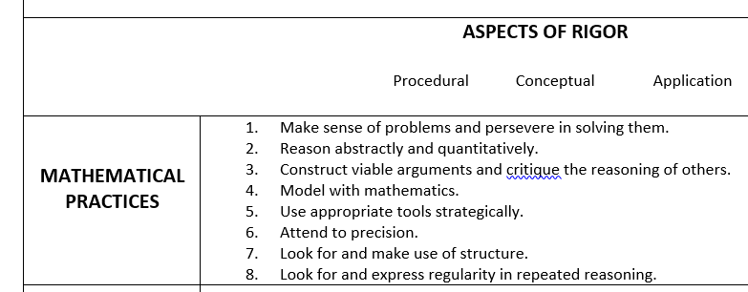
Notes:
What you can say – Before we get started with the unpacking, though, let’s refresh our understanding by zooming in on two key parts of this document <click> Aspects of Rigor and Mathematical Practices.
Additional Notes – None

Slide 4
What Is Rigor?
Stop & Jot: How have you heard the word “rigor” used in your school or district?
Notes:
What you can say – Let’s start with rigor. Let’s review how to determine what aspect(s) of rigor are found in some standards.
Speaker Notes:
Ask participants to write and share how they have heard the word “rigor” used in the their school or district (e.g., by their colleagues, principals, or district leaders).
Consider asking participants to share what they wrote. The emphasis here is on misconceptions; for example, some participants may share that people have used “rigor” to mean “hard” or “challenging.”
Additional Notes – None
Image: “Notes” by Brady (Flickr)

Slide 5
“Rigor refers to deep, authentic command of mathematical concepts, not making math harder or introducing topics at earlier grades.”
Notes:
What you can say – A common misconception is that rigor just means “hard.” It doesn’t. “Rigor” has a specialized meaning in the context of math. “Rigor refers to deep, authentic command of mathematical concepts, not making math harder or introducing topics at earlier grades.”
Rigor has everything to do with how students engage with mathematical content: it implies a balance of conceptual understanding, procedural skill and fluency, and application.
Image: “’Incomplete’ Bridge” by Ken Scarboro (Flickr)

Slide 6
Rigor Unpacked
Conceptual Understanding
is associated with higher order thinking skills, working with multiple representations, and generally moving beyond performing procedures.
Procedural Skill & Fluency
ACCURACY
EFFICIENCY
FLEXIBILITY
fluency is explicitly called for in certain standards
Application
can be thought of generally as problem solving, in real-world or mathematical contexts
Notes:
Notes: The presenter can click each box in one at a time.
What you can say -- The standards name and emphasizes three aspects of rigor.
Conceptual Understanding: Instead of teaching math as a series of mnemonics and discrete procedures, students should build a conceptual framework that supports students in accessing concepts from different perspectives. Conceptual understanding supports fluency and application.
From the front matter of the Standards: “But what does mathematical understanding look like? One way for teachers to do that is to ask the student to justify, in a way that is appropriate to the student’s mathematical maturity, why a particular mathematical statement is true or where a mathematical rule comes from.”
Procedural Skills and Fluency refers to both to “skills” and “fluency.” Students do need to have speed with calculations (e.g., single-digit facts) in order to access more complex concepts and procedures.
Application is not “just doing a bunch of real-world problems,” but should genuinely require that students know which ideas to apply when.
Additional Notes – None

Slide 7
Aspect of Rigor in the Standards
“To help students meet the expectations of the Standards, educators will need to pursue, with equal intensity, three aspects of rigor: (1) conceptual understanding, (2) procedural skill and fluency, and (3) applications. The word ‘rigor’ isn’t a code word for just one of these three; rather, it means equal intensity in all three. The word ‘understand’ is used in the Standards to set explicit expectations for conceptual understanding, and the phrase ‘real-world problems’ and the star symbol (★) are used to set expectations and flag opportunities for applications and modeling. (Modeling is a Standard for Mathematical Practice as well as a content category in High School.) The High School content standards do not set explicit expectations for fluency, but fluency is important in high school mathematics.”
–High School Publishers’ Criteria for the Common Core State Standards for Mathematics
Notes:
What you can say – Although this quote came from the Common Core, it applies to the NYS Next Generation standards as well. Please take a moment to read through this.
<after they have read through the quote> Turn to an elbow partner: Together decide on one phrase from the quote that seems to be the MOST important to you.
<Whole group share out> Points to highlight during the discussion include:
“equal intensity in all three” – rigor is not a code for just one of the listed aspects…
“The word ‘understand’ is used in the Standards to set explicit expectations for conceptual understanding”
“The phrase ‘real-world problems’ and the star symbol (★) are used to set expectations and flag opportunities for applications and modeling” – be certain they understand that the (★) means that the instruction MUST follow the modeling process, which is described in the introduction to the high school standards.
Additional Notes – In the Common Core, fluency expectations did not exist for high school. These expectations have been added for the NYS Next Generation Math standards.

Slide 8
NY-2.OA.1a Use addition and subtraction within 100 to solve one-step word problems involving situations of adding to, taking from, putting together, taking apart, and comparing, with unknowns in all positions.
e.g., using drawings and equations with a symbol for the unknown number to represent the problem.
NY-2.OA.1b Use addition and subtraction within 100 to develop an understanding of solving two-step word problems involving situations of adding to, taking from, putting together, taking apart, and comparing, with unknowns in all positions.
e.g., using drawings and equations with a symbol for the unknown number to represent the problem.
G-CO.B.8: Explain how the criteria for triangle congruence (ASA, SAS, SSS, AAS and HL (Hypotenuse Leg)) follow from the definition of congruence in terms of rigid motions.
Notes:
What you can say – In your materials you will find a slide with three standards. Please pull that out.
Additional Notes – None

Slide 9
Aspects of Rigor
Conceptual Understanding: The Standards call for conceptual understanding of key concepts, such as place value and ratios.
Procedural Skills and Fluency: The Standards call for speed and accuracy in calculation.
Application: The Standards call for students to use math in situations that require mathematical knowledge.
Notes:
What you can say – Your job is to ….
Examine the standards provided and highlight the language that represents each aspect of rigor. Use green for Conceptual Understanding, yellow for Procedural Skill and Fluency, and pink for Application. Remember some standards may have more than one aspect.
NEEDS:
Sample standards to highlight
3 color highlighters

Slide 10
NY-2.OA.1a Use addition and subtraction within 100 to solve one-step word problems involving situations of adding to, taking from, putting together, taking apart, and comparing, with unknowns in all positions.
e.g., using drawings and equations with a symbol for the unknown number to represent the problem.
NY-2.OA.1b Use addition and subtraction within 100 to develop an understanding of solving two-step word problems involving situations of adding to, taking from, putting together, taking apart, and comparing, with unknowns in all positions.
e.g., using drawings and equations with a symbol for the unknown number to represent the problem.
G-CO.B.8: Explain how the criteria for triangle congruence (ASA, SAS, SSS, AAS and HL (Hypotenuse Leg)) follow from the definition of congruence in terms of rigid motions.
Notes:
What you can say – Let’s share out: What are the aspects of rigor associated with each standard?
<Lead the discussion – Move to the next slide after gathering a few thoughts/ideas>

Slide 11
NY-2.OA.1a Use addition and subtraction within 100 to solve one-step word problems involving situations of adding to, taking from, putting together, taking apart, and comparing, with unknowns in all positions.
e.g., using drawings and equations with a symbol for the unknown number to represent the problem.
NY-2.OA.1b Use addition and subtraction within 100 to develop an understanding of solving two-step word problems involving situations of adding to, taking from, putting together, taking apart, and comparing, with unknowns in all positions.
e.g., using drawings and equations with a symbol for the unknown number to represent the problem.
G-CO.B.8: Explain how the criteria for triangle congruence (ASA, SAS, SSS, AAS and HL (Hypotenuse Leg)) follow from the definition of congruence in terms of rigid motions.
Notes:
<Continue the discussion from the previous slide>
Additional Note: The aspects for rigor are not always neatly separated. A single standard often addresses more than one aspect.

Slide 12
Notes:
What you can say – The glossary of verbs from the NYS website is another reference tool that can be used as a resource to help connect and understand the language of the standards.
http://www.nysed.gov/curriculum-instruction/glossary-verbs-associated-new-york-state-next-generation-mathematics-learning

Slide 13
Notes:
What you can say – Remember that we are not going to try to unpack ALL of the standards immediately. We recently prioritized the standards. Please pull out the top standard from your prioritized list for your grade level/course.
Additional Notes – None

Slide 14
Aspects of Rigor
Conceptual Understanding: The Standards call for conceptual understanding of key concepts, such as place value and ratios.
Procedural Skills and Fluency: The Standards call for speed and accuracy in calculation.
Application: The Standards call for students to use math in situations that require mathematical knowledge.
Notes:
What you can say – Work with your colleagues to dig into that standard to identify the aspects of rigor. Highlight them just as we did with the samples. Remember that some standards may have more than one aspect. Let’s work on this for about x minutes. <Probably about 5 minutes, but adjust based on the comfort level of the participants with the math>
Additional Notes –This will give a visual picture of the rigor in the standard that they will be unpacking.
NEEDS:
Sample standards to highlight
3 color highlighters

Slide 15
Notes:
What you can say – Now let’s focus on the Mathematical Practices.
Additional Notes –None

Slide 16
Standards For Mathematical Practice
Make sense of problems and persevere in solving them.
Reason abstractly and quantitatively.
Construct viable arguments and critique the reasoning of others.
Model with mathematics.
Use appropriate tools strategically.
Attend to precision.
Look for and make use of structure.
Look for and express regularity in repeated reasoning.
Notes:
What you can say – One piece that has NOT changed from the Common Core are the Standards for Mathematical Practice. Unfortunately, the Practices were often set on the back burner because we were so focused on the new content standards. Since the content has not changed significantly, we now have the opportunity to place the focus on the Practices… and doing so places more emphasis on student thinking and processing, which is what we want.
Turn your papers face down, and put your phones away – no looking this up!
Grab a post it note and a pen.
Walk around the room for the next 5 minutes and ask your colleagues. See if you can list all of the Standards for Mathematical Practices on your post-it note. Ready? Go!
<Call the participants back after 5 minutes (or shorter if they seem to be drifting off topic). Then click through the Practices listed on the slide one by one so they can check their lists.>
Then you can say – It is vital that all students are engaged in ALL of the Mathematical Practices to support their work on the content standards. Students must have access to grade-level mathematics with a balance of rigor, and the standards must be scaffolded into this content – working toward independence without a simplification of tasks.
If you are looking for a more complete description of each Mathematical Practice, look in the Introduction of the Math Standards document.
A final note – Practices 4 and 5 are often confused: MP 4, MODEL WITH MATHEMATICS, means applying math to the real world. MP 5, USE APPROPRIATE TOOLS STRATEGICALLY includes the sentence, “These tools might include pencil and paper, concrete models, a ruler, a protractor, a calculator, a spreadsheet, a computer algebra system, a statistical package, or dynamic geometry software”
Additional Notes – None

Slide 17
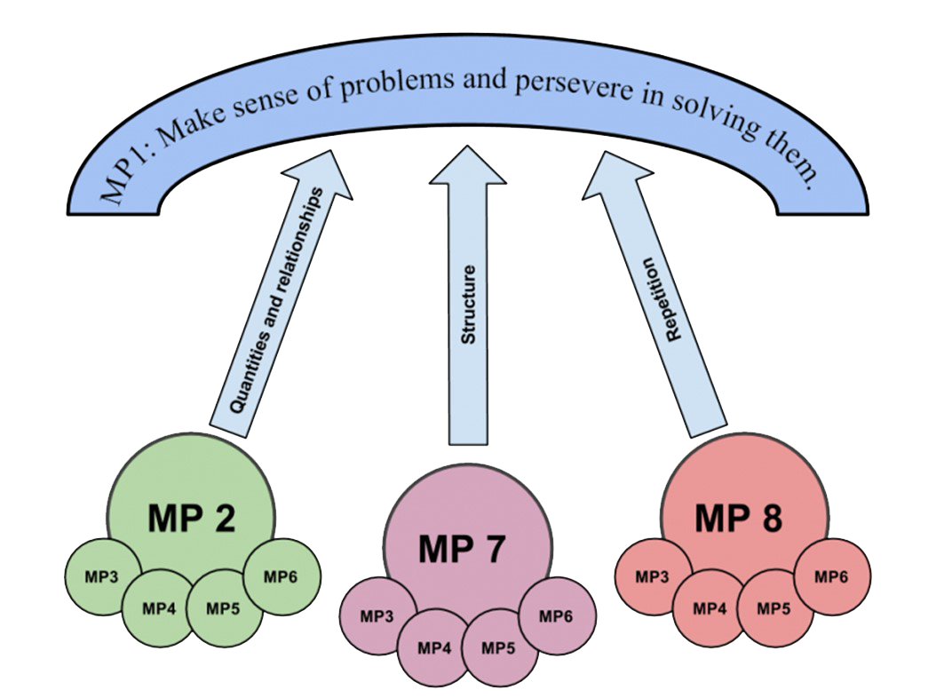
Avenues of Thinking
Adapted from FosteringMathPractices.com
Notes:
<MP = Mathematical Practice>
What you can say – Without MP1, math isn’t happening! MP1 is make sense of problems and persevere in solving them.
All the other math practices sit in service of this goal, because if a student gives up, there is no opportunity for any other mathematical thinking to occur.
MPs 2, 7, and 8
These three practices describe three different avenues of mathematical thinking that provide entry into, and through, all kinds of math problems. It is crucial that students develop facility with all three of these types of thinking. This allows them to develop the tenacity it takes to persevere through complex math problems where problem-solving dead ends or computational road blocks require the problem solver to try another avenue.
MPs 3, 4, 5, 6
These practices describe important ways to navigate down each avenue.
Additional Notes – None

Slide 18
Notes:
What you can say – When you are looking to find connecting Mathematical Practices, check beneath the content standards
Additional Notes – None

Slide 19
Unpacking Guide
Notes:
What you can say: Okay – we have reviewed Rigor and the Practices because they are an integral part of INSTRUCTING the standards. Therefore, they are critical to the unpacking process. Now we can start the full unpacking of a standard.
Let’s put this in context again. You have already prioritized your standards. We are now going to take one of those high priority standards and really dig into it. We want to break it down to a level that allows us to fully understand what we are supposed to do with it, what the students should walk away with, and how it connects to prior and future learning.
Additional Notes – None

Slide 20
Notes on the following slides
Walk through and practice.
At this point, participants should have selected the first standard that they are going to unpack.
In your districts, use the Grade 6 sample as a model. After each slide, give participants a chance to complete that section for their selected standard.
The times identified in the notes of the following slides are suggestions. Some people will be done early and some will belabor every point. Find a happy medium. You don’t have to wait until everyone is finished in order to move on.

Slide 21
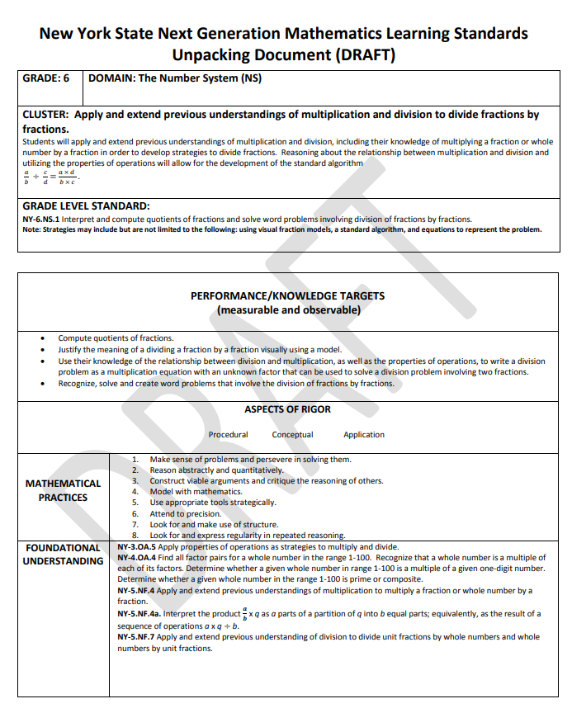
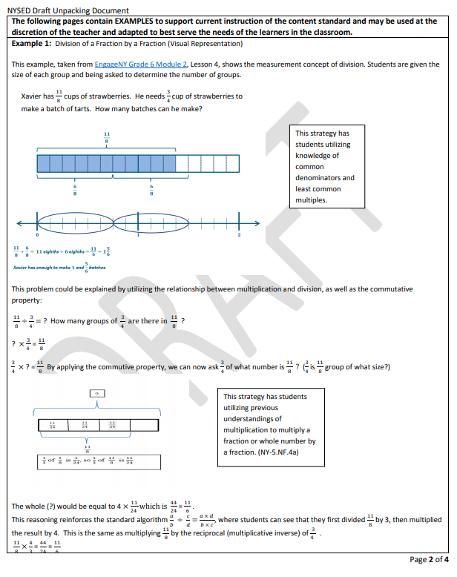
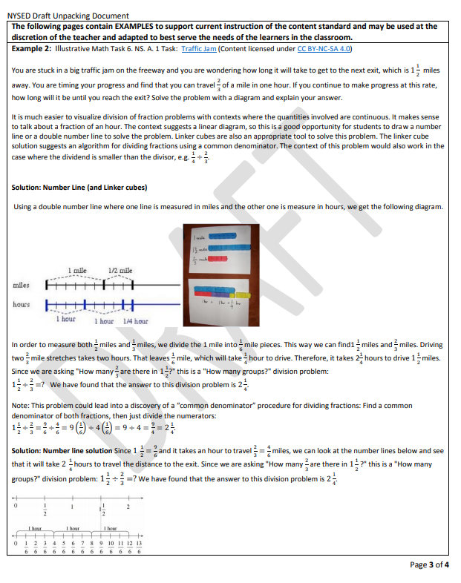
Grade 6 Unpacking Sample
Notes:
What you can say: Take out the 6th grade unpacking document sample. You will also need to access a blank copy of the format, which can be found __________________. Save a copy to ___________.
<Click to move on… do not spend a great deal of time on this page>
Additional Notes – The blank could be distributed either electronically or on paper. Time can be saved by asking participants to download the blank prior to the workshop.

Slide 22
Notes:
What you can say – Finally, you will need access to the standards document. When you are looking for additional support, we recommend that you make use of the Broome-Tioga BOCES “Enhanced Version” of the Math Standards.
<Give participants access to this – either the website now, or send them the link before the workshop>
<Click to open the standards, then go to this standard on page 79. Show the “hover over” of the red text and the hyperlinks tied to the blue text. Also show the “suitcase” – there are two standards unpacked at most grade levels as samples>
<Don’t spend a ton of time here… move back to the unpacking>
Additional Notes -- None

Slide 23
Grade 6 Unpacking Sample
Notes:
What you can say: Together we will walk through the format using the sample as a guide. After each section, you will have an opportunity to work on your own standard, so take a moment now to access a standard that you identified as a “priority standard.”
Additional Notes – Be aware of your timing in the following slides. Some people will be done early and some will belabor every point. Find a happy medium. You don’t have to wait until everyone is finished in order to move on.

Slide 24
Notes:
What you can say – The Grade and Domain are simple enough to fill out, as is the Grade Level Standard. (This is the standard that you are going to unpack.) Some time, though, will need to be spent processing the Cluster. <Click for emphasis>
Additional Notes – Show the sections, then move immediately to the next slide.

Slide 25
Notes:
You can say this – The cluster is above the standard, and that can be copied directly to the form <point to the bold text, then click> What comes after is YOUR interpretation of the cluster in your own words. What does it mean? What is it asking for? Remember that these documents are meant to help US understand where we need to guide the students, so putting this information into our own words forces us to process it deeply and put the standard into the context of the larger picture… the cluster.
If you are looking for a little more depth on a cluster, you can go back to the NYS Modules. They have some great descriptions of the intent. Remember, though, that those are based in the Common Core, so there will be a few differences.
Additional Notes – Walk through this, then move immediately to the next slide.

Slide 26
Notes:
What you can say – Now it is your turn. Take about 15 minutes to complete this section based on the prioritized standard that you selected.
Additional Notes – None.

Slide 27
Notes:
What you can say – Now that we have an idea of the goal of this cluster, we can look at an individual standard within the cluster. We need to identify what the students should know and what they should be able to do by the time we have completed this standard. Take a moment and compare the standard on the 6th grade sample to the Performance/Knowledge Targets that have been identified. <Give some time for the participants to read and process>
What did you notice about the targets?
<Based on the responses that you receive, you may want to emphasize the following:
Notice that these all start with a verb. Also note that the phrase “The students can…” is implied at the beginning of each of these phrases! If we look at the second bullet, my students need to be able to justify the meaning… not simply restate a justification that I give them.>
Look at your prioritized standard and the cluster that it belongs to – What are the “The students can…” statements that will let you know the children have mastered this standard? Take about 15 minutes to complete this section based on the prioritized standard that you selected.
Additional Notes -- None

Slide 28
Notes:
What you can say – We have reviewed Aspects of Rigor and Mathematical Practices… Now it is time to put that knowledge to use.
Additional Notes – NYS Education department did not include “answers” to these parts in their unpacked samples… we don’t know why…

Slide 29
Notes:
What you can say – Remember that you can always get additional support from the Enhanced Standards document. <Click>
Additional Notes – None

Slide 30
Notes:
What you can say – Take some time now to identify the aspects of rigor in the standard, and then identify the Mathematical Practices. Let’s check in again in about 15 minutes.
Additional Notes – None

Slide 31
Notes:
What you can say – Now we move on to the Foundational Understanding. What do the students need to know and be able to do in order to access this priority standard. Again, this is not about filling out the paperwork… this is about us understanding those places where we may need to differentiate our instruction. We may need to provide appropriate scaffolding for some of the children to access this standard. That will be easier if we deeply understand what the standard is built upon.
Additional Notes – None

Slide 32
Notes:
What you can say – We can find these connections in the standards document or in the modules. We also have access to the Coherence Maps for the Common Core. <Show quickly, then click>
Additional Notes – Give link now or ahead of time…

Slide 33
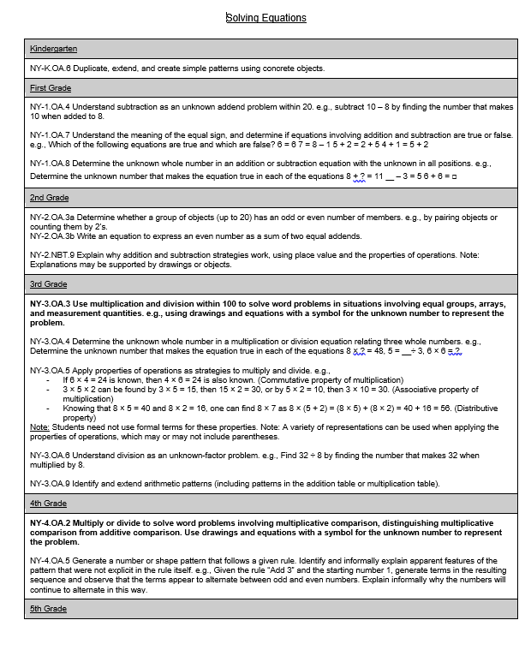
Notes:
What you can say – There are also progressions that someone from the statewide developed <Show quickly – midway down the page and on the left. Then click>
Additional Notes – Give link now or ahead of time…

Slide 34
Notes:
What you can say – Go ahead and dig into the foundational understandings for your priority standard for the next 15 minutes or so.
Additional Notes – None

Slide 35
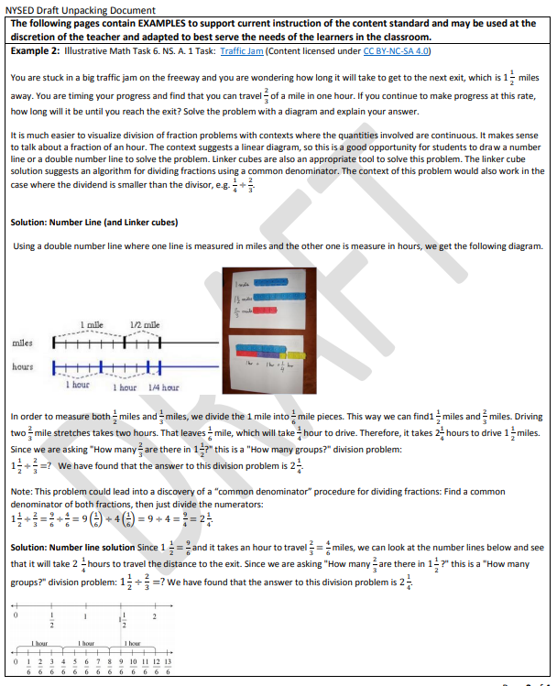
Building Examples
Notes:
What you can say – Now we move on to examples that support current instruction. Teachers should determine key instructional tasks that are aligned to the aspects of rigor identified in section II. These tasks should allow for the development and the mastery of the learning targets outlined in section II. These are NOT intended to be a collection of assessment items; rather, they are a collection of examples that can be used in conjunction with current teaching practices to help enhance student learning of the standard. This section may differ from district to district due to curricular resources. Teachers are encouraged to show a representation in the concrete, pictorial, abstract progression. This will allow for equitable on-grade level instruction for all students.
Go ahead and dig into the examples to support current instruction for your priority standard for the next 15 minutes or so.
Additional Notes – None

Slide 36
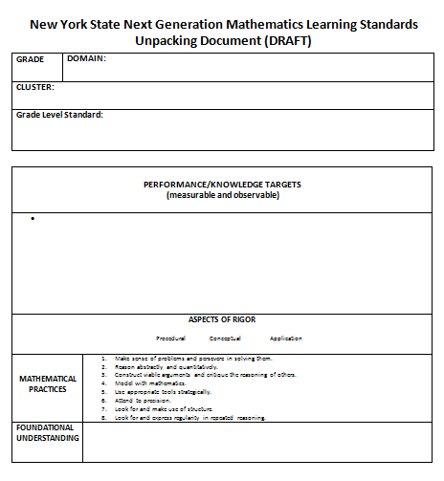
Notes:
What you can say – Unpacking learning standards is an excellent exercise in “reflective” practice and districts are encouraged to continually update and modify these documents to best serve the needs of their learners and mathematical programs.
Additional Notes – None

Slide 37
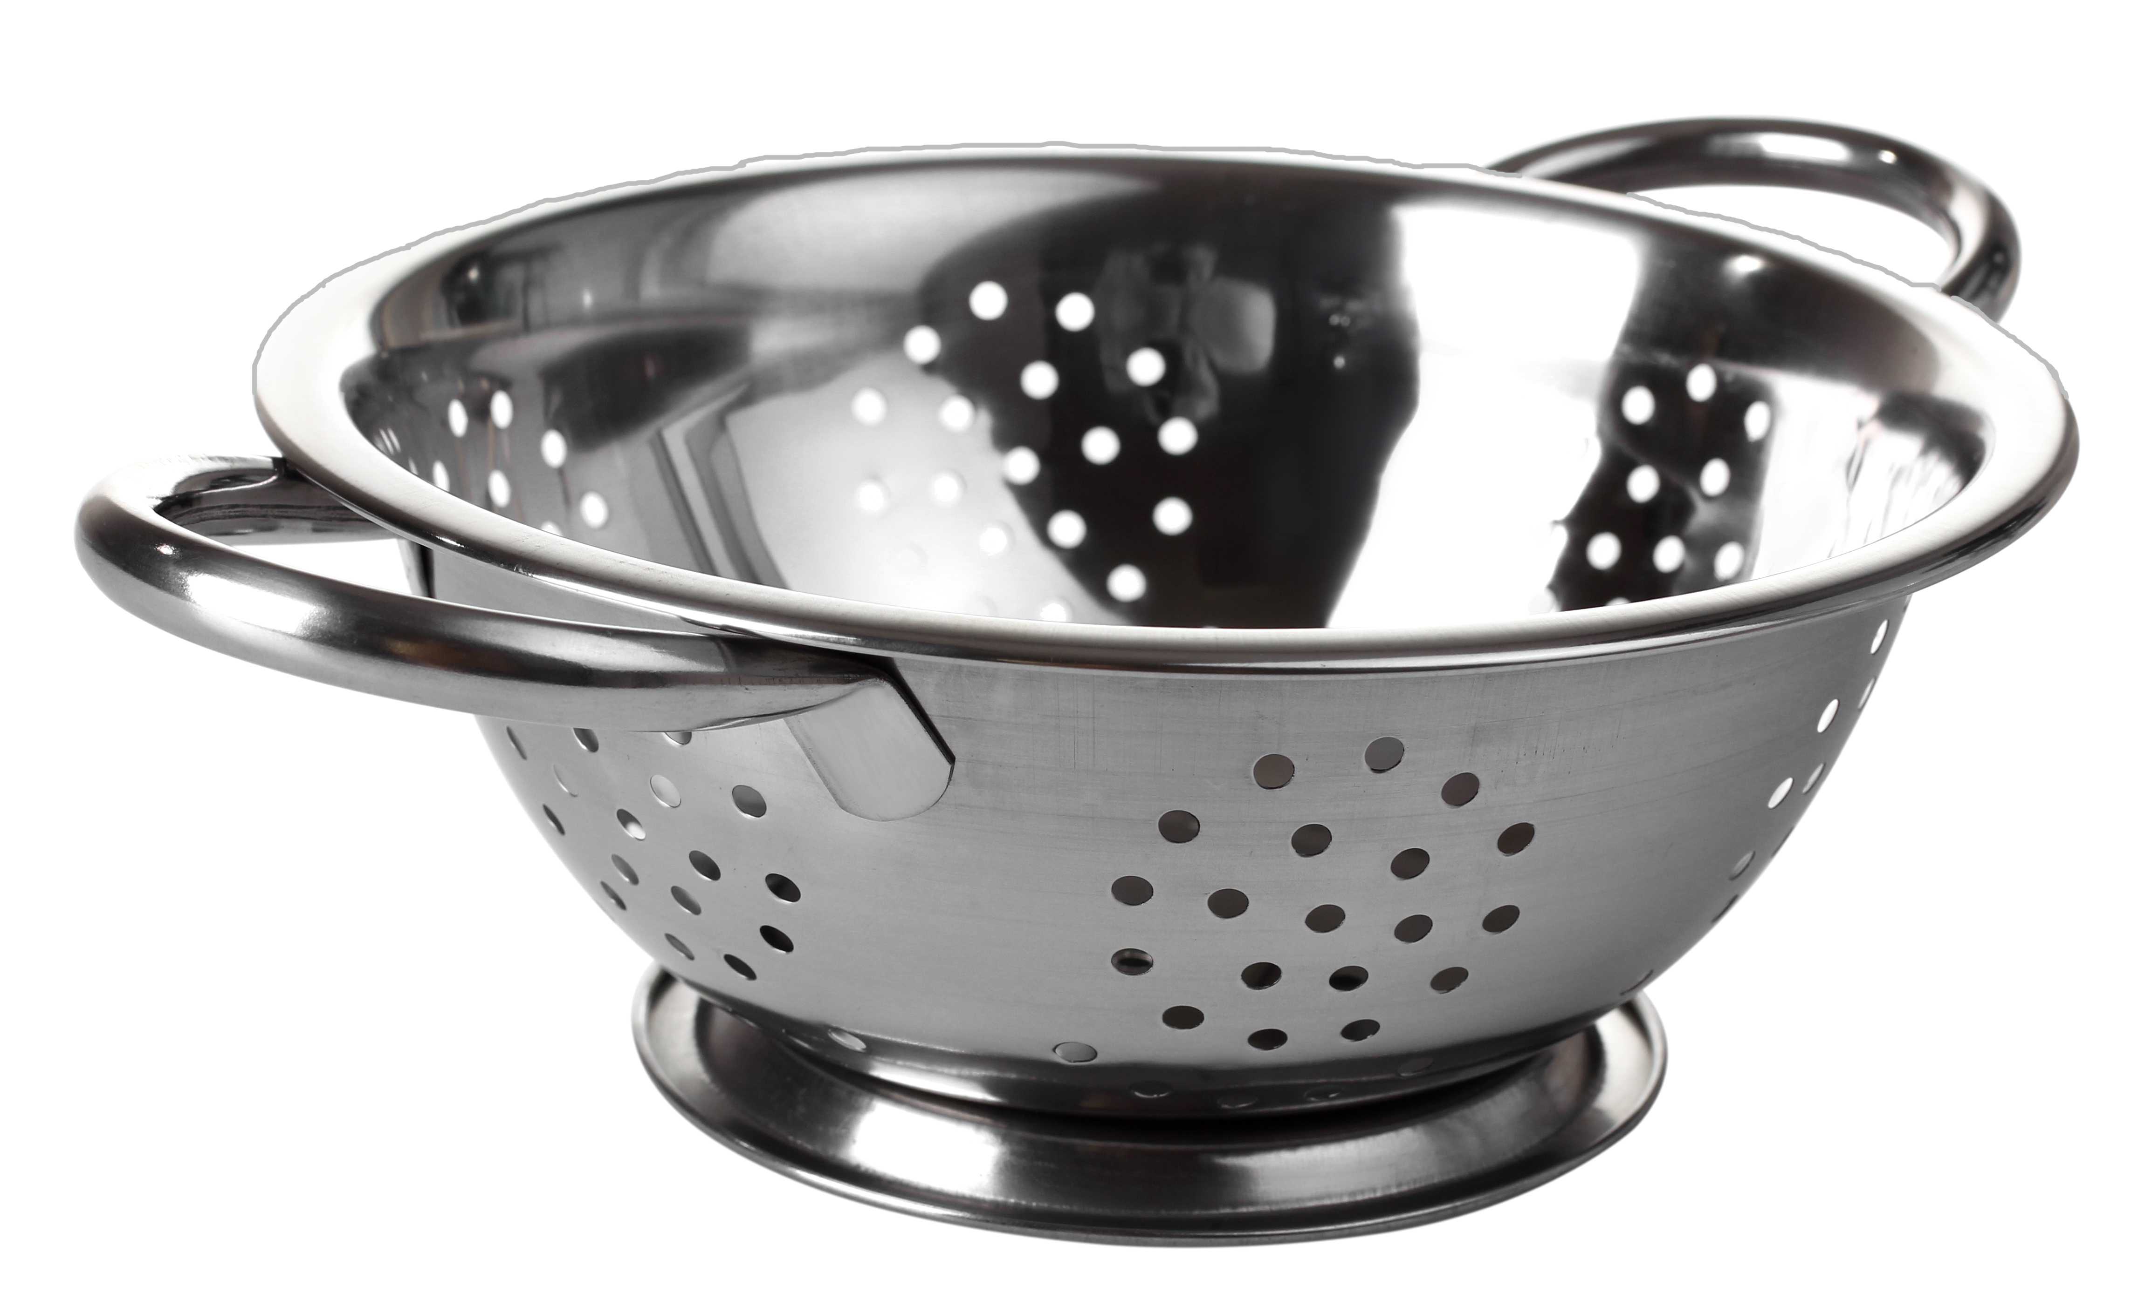
Getting’ Synectic
Unpacking a Standard Is
Like A... Because...
OR
OR
Notes:
What you can say: As you think about the process of unpacking a standard, choose one item from above: a bike wheel, a colander, or a cook book, make a synectic incorporating what you learned about unpacking…Write this down on a index card or post-it and then share at the tables…<ask for a few to share aloud>
Additional notes: Give about 2 minutes for thinking and about 4 minutes for sharing out at tables and a few in large group.

